Slide 1

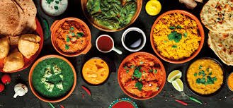
Fridge Fren
The Friendly Recipe Search
Application
May 2023
Daniel Stanton, Federico Dordoni & Natalie Campbell
Eat great. Feel greater!

Slide 2
Fridge Fren
Are you tired of staring at a fridge full of random ingredients and not knowing what to make for dinner?
Fridge Fren® is here to save the day, night or dish!
Our friendly app provides a wide range of recipes based on the ingredients you have on hand, allowing you to make delicious and creative meals without wasting food or breaking the bank. With Fridge Fren, cooking has never been easier or more fun.
Eat great. Feel greater!
Notes:
Elevator pitch -

Slide 3
Concept
Fridge Fren is a recipe app that helps users create delicious meals using the ingredients they already have in their fridge. By simply inputting the ingredients they have on hand, the app provides recipe suggestions that use those ingredients, reducing food waste and saving time and money.
The application allows you to search for recipes based on:
ingredients
cuisines
recipe names
and links you to over 5000 recipes!
With a vast database of recipes and the ability to save favorite recipes, Fridge Fren encourages users to experiment with new ingredients and cooking methods, making cooking an exciting and creative experience.
The application aims to and is designed to help users reduce food waste, cut living costs and save time by making the process of finding recipes simple.
Eat great. Feel greater!

Slide 4
User Story
AS A foodie
I WANT TO create new recipes based off what I have in my fridge
SO THAT I can save money and time
WHEN I enter an ingredient in the search bar
THEN I am presented with an array of choices (recipes) relevant to the search input
WHEN I click on one of them
THEN I am presented with the recipe instructions with all its data
WHEN I click on the Add To Favorite
THEN the relevant recipe gets saved in my local storage
SO THAT it can be restored at a later date
WHEN I interact with the Random Food Fact
THEN I learn about food facts
WHEN I want to add the recipe to my calendar
THEN I can add it to a google calendar for meal planning
Eat great. Feel greater!

Slide 5
Process
Technologies used:
HTML
JavaScript
APIs
Tailwind css
User inputs ingredients they have on hand into Fridge Fren's search bar
Fridge Fren uses the Spoonacular API to search for recipe ideas based on those ingredients
The app displays a list of recipe suggestions that match the ingredients entered by the user.
Once a recipe is selected, Fridge Fren provides step-by-step instructions and a list of additional ingredients
Users can save their favorite recipes for future reference
Fridge Fren also utilizes Google Calendar API to add your recipe to your google calendar
Eat great. Feel greater!

Slide 6
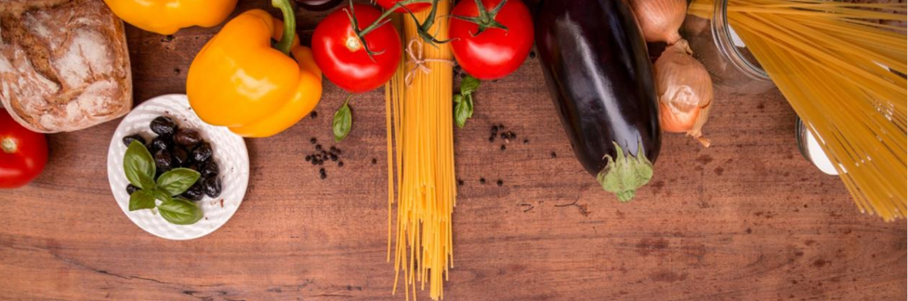
DEMO
Eat great. Feel greater!
Notes:
https://github.com/stanno03/Fridge-Fren

Slide 7
Breakdown of tasks and roles
The development of the app had stages of planning, development and testing. The planning was assigned to all using Lucidspark wireframe and flowchart while the development was split into three pages, each team member assigned to one page:
Home page
Search page
Results page
During development, the three pages were merged for user experience. Each team member was involved in the overall design and testing of the app. The project board kept the team on track. The API’s originally selected proved a hurdle, and the design was continuously discussed and improved as the project progressed.
Eat great. Feel greater!

Slide 8
Challenges
TikTok api key permission denied, tried and tested the TikTok dev tools embed to embed a user
Decided that the TikTok embed wasn’t a true API call
Redesigned the second API as a fun, interactive aspect of the app for the user
Github process of using version control with users inexperienced in the branching and merging
Admin access for installation
Eat great. Feel greater!

Slide 9
Successes
Acceptance Criteria
☑ GIVEN I new a recipe to cook a meal for
☑ WHEN I add search input
☑ THEN I am presented with a list of recipe options
☑ WHEN I select the recipe I want to explore
☑ THEN I am directed to the ingredients and instructions for the dish
☑ WHEN I select the random food facts
☑ THEN I am presented with a random food fact
☑ WHEN I like a recipe
☑ THEN I am able to favourite that recipe
☑ WHEN I want to recall my favourite recipes
☑ THEN I can access the favourite recipes
☑ WHEN I want to add the recipe to a calendar
☑ THEN I can add a recipe to my google calendar
Eat great. Feel greater!

Slide 10
Directions for Future Development
Expanding the search to use other parameters such as cost or cooking time
Linking the meal planner to smart fridges for shopping lists
Creating a pantry to select all user’s pantry items
Socials links
TikTok API/token
Link to nutrition tracking apps
There are so many branches that could be utilised for this app!
Eat great. Feel greater!

Slide 11
Links
https://github.com/stanno03/Fridge-Fren
https://stanno03.github.io/Fridge-Fren
Eat great. Feel greater!

